Slide 1
BCS Wiring Guide

Slide 2
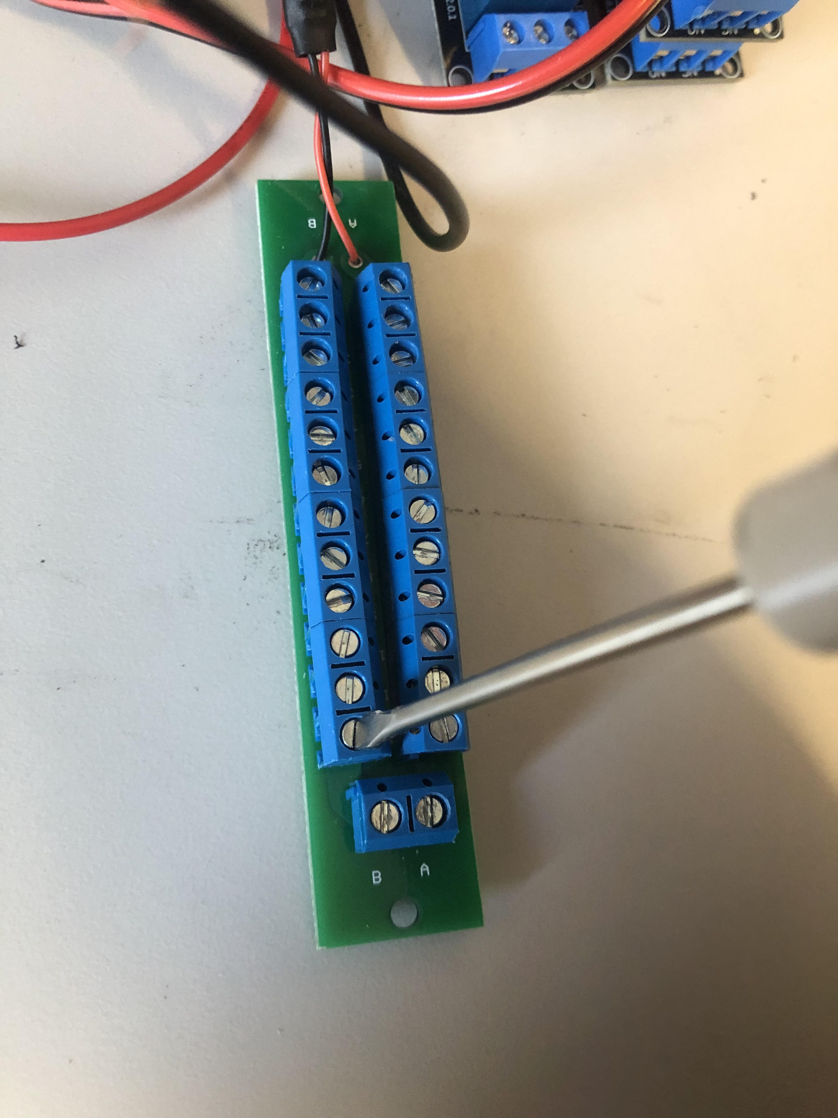
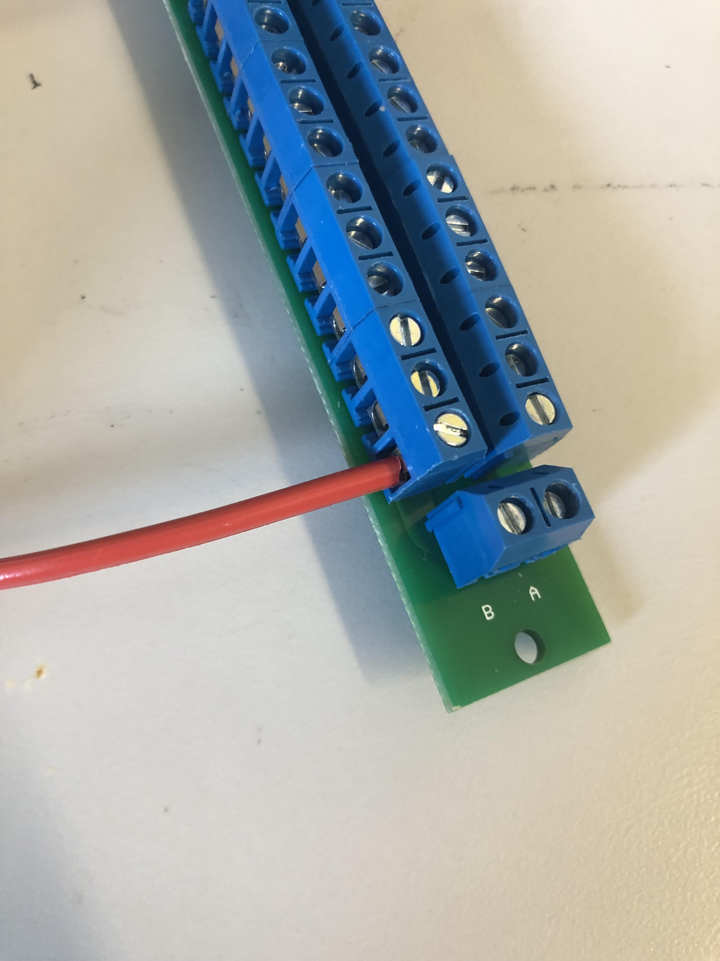
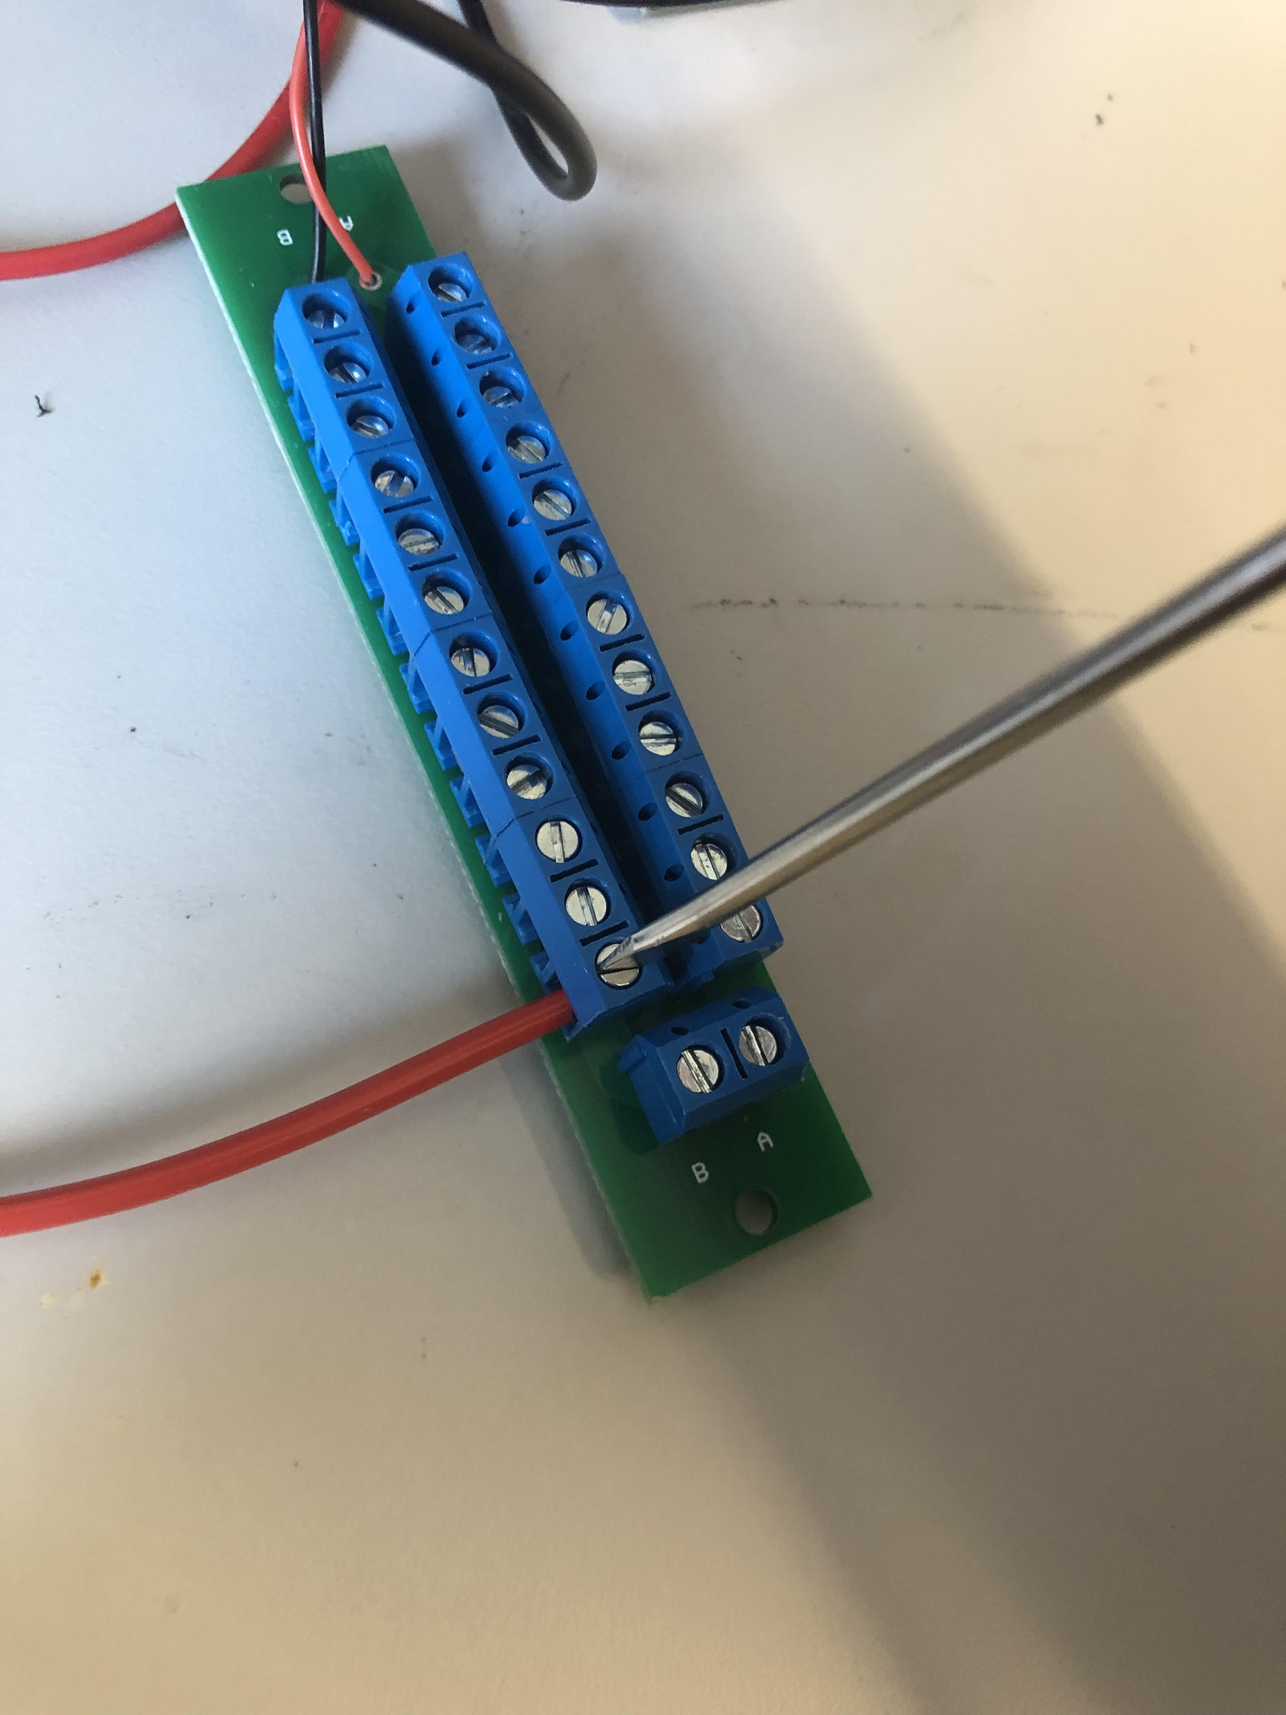
Fixing the wire on the Power Distribution Panel (PDP)
Use the screw driver to loosen the PDP screw
Stick the exposed wire core in the clench
Tighten the screw with the screw driver

Slide 3
Wiring Diagram is in Next Page
For clarity purposes, the wiring diagram only shows the wiring diagram to control one bucket:
1 set of relay + connector wiring
1 set of fan switch + connector wiring
Replicate the wiring in the box for five times, as you can see there is 5 relays on the relay PCB

Slide 4
To Controller PCB
Do relay+5.5mm connector 5 times
Do switch+5.5mm connector 5 times
Switch
5.5 mm Connector
To 24V Power Source

